Slide 1


Slide 2
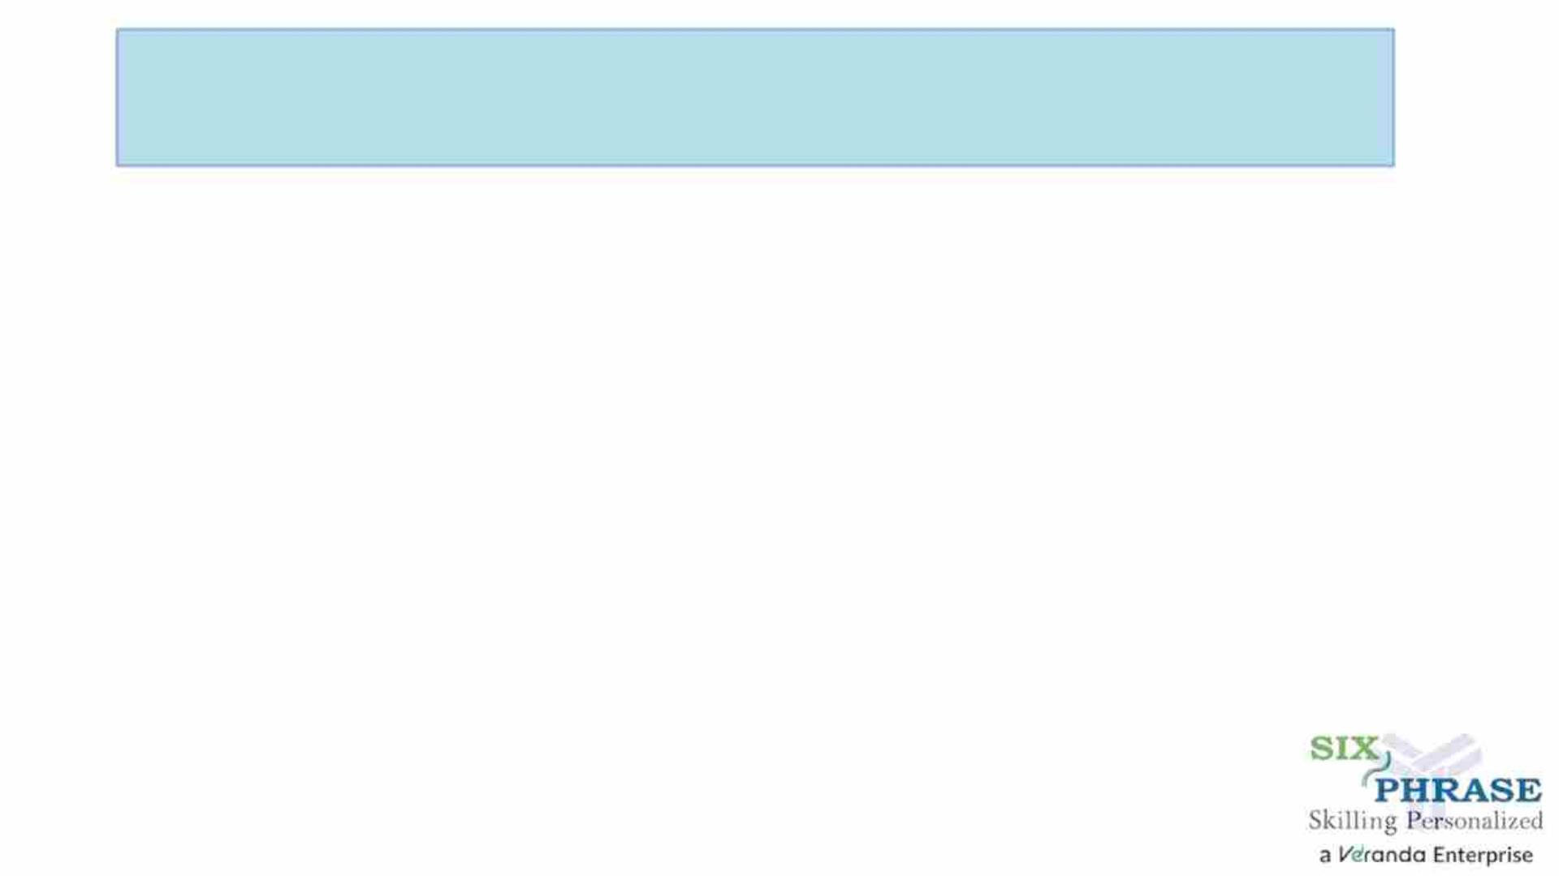
Emotional Intelligence Skill Test
Course Code : MSTS502P
Course Title :
Credits : 1
Prerequisites : NA
Antirequisites : NA

Slide 3
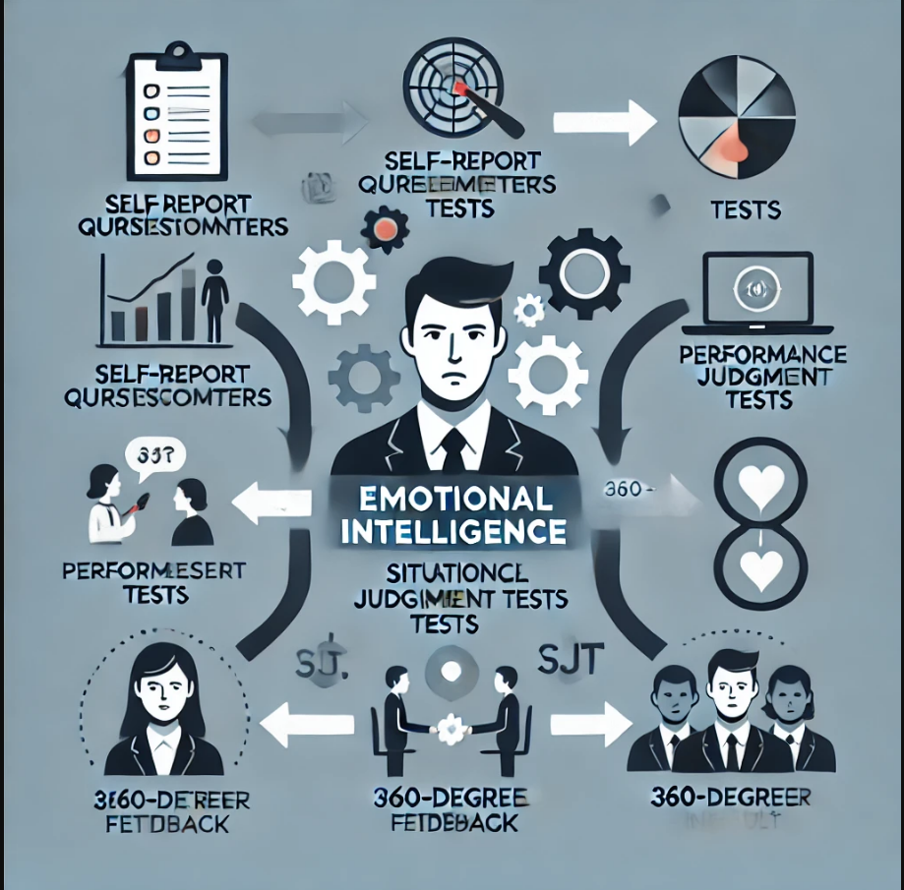
An Emotional Intelligence Skill Test is a structured assessment designed to measure an individual's ability to recognize, understand, manage, and influence emotions in themselves and others. These tests evaluate key emotional intelligence (EI) components such as self-awareness, emotional regulation, motivation, empathy, and social skills.

Slide 4
They are used in various fields, including education, workplace environments, leadership development, and mental health, to assess and improve emotional competencies for better decision-making, communication, and interpersonal relationships.
Emotional intelligence is learned and learnable.
Key points:
Managers with emotional intelligence (EI) achieve objectivity through their self-awareness, which promotes productive, motivated, and equal workplaces
Daniel Goleman’s emotional intelligence theory outlines five components of EI: self-awareness, self-regulation, motivation, empathy, and social skills
Emotional intelligence can be learned and applied to meet goals and targets, as well as create a happier and healthier working culture

Slide 5
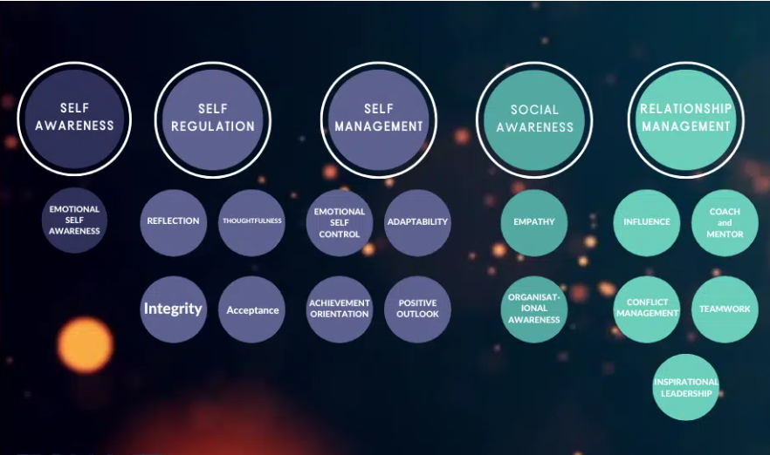

Slide 6
Goleman breaks down EI into five components:
1. Self-awareness
2. Self-regulation
3. Motivation
4. Empathy
5. Social skills

Slide 7
1. Self-awareness
Self-awareness is the ability to recognize and understand your own thoughts, feelings, and emotions, which can all affect your interactions with others.
Self-awareness helps you temper your communication style and gives you a reason to listen to the people around you.
In other words, you’re self-aware enough to know when you need help, and from whom and how you can apply your characteristics to achieve a favourable outcome.
Notes:
💡A Working Example of Low Self Awareness💡
Luka, a newly promoted manager in an office environment, is helping his team complete their day-to-day tasks. His actions are being interpreted as micromanaging.
Luka senses the tension but hasn’t made the mental jump from worker to manager. He doesn’t realise his actions are detrimental to team performance.
When Luka’s employees say: “Don’t worry, you’re busy, I can do it”, he doesn’t hear the truth of the statement – that his focus should be elsewhere – and assumes they’re demotivated.
A solution: To gain more self-awareness as a new manager, Luka could keep a self-reflective journal, to help him process the situation. Or, he could use the Eisenhower Matrix to help him prioritise and delegate.
For example:
If you are a manager with low self-awareness, you may struggle to recognize and understand your own emotions and thoughts, which can lead to difficulty in regulating your behavior and making sound decisions.
If you are a manager with heightened self-awareness, you have the ability to recognize and understand your own emotions and thoughts, and how they impact your behavior and decision-making.

Slide 8
2. Self-regulation
Think back to your last employer who acted impulsively, or irrationally. Did you trust them? What was work like under their watch?
An emotionally charged environment is usually fraught with unresolved conflict. It feels tense and distracting. You probably felt like you couldn’t contribute without fear of reprimand.
Calm in the face of adversity is not a natural response or something you’re born with.
The emotional brain is far faster (and older) than the rational frontal cortex. It sends us into fight or flight mode whenever we need to defend ourselves, and it can happen at innocuous and frustrating moments.
Notes:
A Working Example of Low Self-Regulation💡
For example, when an employee challenges your decision, or if you’re asked a question you don’t know the answer to in a meeting.
Self-regulation is a skill you need to practice, and there are great rewards if you can master it.
You become approachable, equipped with conflict resolution skills, able to create a nurturing environment and lead by reliable example.

Slide 9
Motivation
Goleman’s third component refers to motivation for enjoyment rather than money or a promotion.
What is motivation at work?
Motivation at work refers to the drive or inspiration an individual feels to perform a task or achieve a goal within their job or career. It is the inner force that drives an employee to put in the effort required and achieve success in their work.
There are different types of motivation, such as intrinsic motivation, which comes from within oneself and is driven by personal interest and enjoyment, and extrinsic motivation, which comes from external factors such as rewards or incentives.
Notes:
💡Five things you can do to drive self-motivation💡
Find meaning and purpose in your work: When you feel that your work is important and has a greater purpose, you’re more likely to feel motivated and engaged.
Set clear, specific, and challenging goals for yourself: Having a clear sense of what you want to achieve and a plan for how to get there can provide direction and purpose, and increase motivation.
Focus on your strengths: Emotionally intelligent individuals tend to be aware of their own strengths and use them to their advantage. Instead of focusing on your weaknesses, focus on what you do well and use that to drive your motivation.
Self-reflect and monitor your emotions: This can help you to be aware of your own emotional state, and help you to recognize when your motivation is low and what might be causing it.
Reward yourself for your progress: Celebrating your progress and small wins can help you stay motivated and focused on your goals.

Slide 10
4. Empathy
If you can understand the emotions of others and relate to them, you can see problems from all perspectives and make objective decisions. Empathy defuses bias.
Being an empathic leader means you’re a good listener and interpreter, attuned to body language and facial expressions.
Notes:
💡A Working Example of Empathy💡
Imagine that you are a manager at a company, and one of your employees has been struggling with their work recently. Instead of immediately jumping to criticism or blame, you could try to understand what might be causing the employee’s poor performance. You could say something like:
“I’ve noticed that your work has not been up to your usual standard lately. Is everything okay?”
An empathic manager is considerate, balanced, and fair.
⏰Key Point: Applying empathy gives you a superpower. You can read what your employees need from you – when they need challenge, when they need constructive feedback, and when they need more training. It’s particularly powerful for leaders dealing with the five dysfunctions of a team.

Slide 11
5. Social skills
It’s important to build a strong rapport with your team.
Not only is it part of good leadership, but it’s also essential to boosting staff productivity and increasing loyalty.
Having solid social skills such as active listening, verbal communication, nonverbal communication, leadership and persuasiveness enables you to connect with your team.

Slide 12
Any disadvantages of using emotional intelligence in the workplace
There are pros and cons. Emotional intelligence in the workplace is extremely beneficial, but there can be disadvantages to using EI too.
Emotional intelligence can be used to manipulate others. While this shouldn’t be on the agenda for anyone in leadership or management, it’s important to be aware that emotionally intelligent members of your team might use EI to their advantage.
However, generally, the use of emotional intelligence at work has a positive impact. It can increase job satisfaction and performance through the following:
Controlling stress and minimizing conflict
Creating smoother, easier adjustments
Improving communication and teamwork
Increasing motivation
Promoting a positive work environment

Slide 13
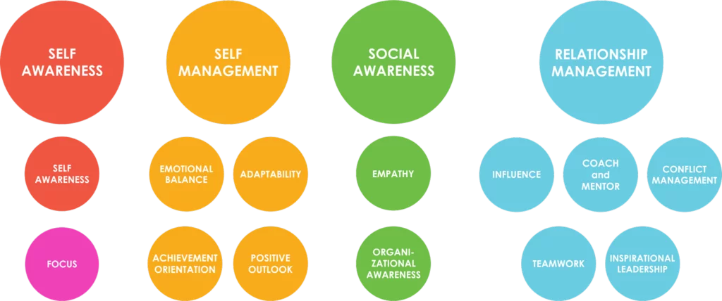
Notes:
There are four domains and 12 competencies in Daniel Goleman’s model of EI.
The four domains are:
Self Awareness
Self Management
Social Awareness
Relationship Management
Under the four domains mentioned above, there are 12 competencies:
Emotional Self-Awareness
Emotional Self-Control
Adaptability
Achievement Orientation
Positive Outlook
Empathy
Organizational Awareness
Influence
Coach and Mentor
Conflict Management
Teamwork
Inspirational Leadership
The 12 Emotional Intelligence Competencies Defined
What is Emotional Self-Awareness?
Emotional Self Awareness lies at the heart of emotional intelligence. Emotional self awareness is the ability to understand our own emotions and their effects on our performance. You realize how your feelings affect you and how well you’re doing. Your values and sense of purpose help set your course of action.
What is Emotional Self-Control?
Emotional Self-Control (also known as emotional balance) is the ability to keep your disruptive emotions and impulses in check to maintain your effectiveness under stressful or even hostile conditions. With emotional balance, you recognize disruptive emotions—emotions that get in the way like high anxiety, intense fear or quick anger—and you find ways to manage your emotions and impulses. You stay calm and clear headed under stress, even during a crisis.
What is Positive Outlook?
Positive Outlook is the ability to see the positive in people in situations and events. It means persistence in pursuing goals despite setbacks and obstacles, you can see the opportunity in situations where others would see a setback that could be devastating, at least for them.
What is Achievement?
The Achievement competence means that we strive to meet or exceed a standard of excellence. We look for ways to do things better. We set challenging goals, we take calculated risks. There’s a big paradox about achievement orientation, and that is when you have positive goals, it’s very helpful. But if you stay in this overdrive all the time and try to drive other people in the same pace, you can become a toxic leader. Even though achievement drive helps you get your career goals, it may make you unhappy in your life.
What is Adaptability?
The Adaptability competence is flexibility and handling change and juggling multiple demands, adapting to new situations with new ideas or innovative approaches. It means you can stay focused on your goals, but easily adjust how you get there. You can meet new challenges and you’re nimble and adjusting to sudden change. You’re comfortable with the uncertainty that leadership can bring.
What is Empathy?
The Empathy competence means you have the ability to sense others feelings and how they see things. You take an active interest in their concerns. You pick up cues to what’s being felt in thought. with empathy, you sense unspoken emotions. You listen attentively, to understand the other person’s point of view, the terms in which they’re thinking about what’s going on. empathic leaders are able to get along well with people of very different backgrounds and cultures, and to express their ideas in ways the other person will understand. Empathy doesn’t mean psyching out the other person so you can manipulate them, but rather, it’s knowing how best to collaborate with them.
What is Organizational Awareness?
Organizational awareness means the ability to read a group’s emotional currents and power relationships, identify influencers, networks, and the dynamics that matter in making decisions. A leader who can recognize networking opportunities and read key power relationships will do a better job at leading. Such leaders not only understand the forces at work in an organization, but also the guiding values and unspoken rules that operate among people.
What is Influence?
Influence as a competence refers to the ability to have a positive impact on others, to persuade or convince them to gain their support. If you’re strong in the influence competence, you’re persuasive and engaging and you can build buy-in from key people. Remember, leadership is the art of getting work done well through other people. And influence is the most powerful way to do that.
What is the Coach and Mentor Competency?
The Coach and Mentor competency is the ability to foster the long term learning or development of others. By giving feedback and support. You have a genuine interest in helping them develop further strengths. You give timely, constructive feedback, you understand the person’s goals, and you try to find challenges for them.
What is Inspirational Leadership?
The Inspirational Leadership competence is the ability to guide people to get the job done to bring up their best. With inspiration, you can articulate a shared mission in a way that motivates and offers a sense of common purpose. Beyond people’s day to day tasks.
What is Teamwork?
The teamwork competence is the ability to work with others toward a shared goal, participating actively sharing responsibility and rewards and contributing to the capability of the team. you empathize and create an atmosphere of respect, helpfulness and cooperation, you can draw others into active commitment to the team’s effort. Leaders skilled at the teamwork competence build spirit, positive relationships, and pride of identity at being on the team. And it’s not just teams. This competence holds the key to collaboration of any kind.
What is Conflict Management?
The conflict management competency means the ability to help others through emotional or tense situations, to tactfully bring disagreements into the open and to define solutions that everyone can endorse. leaders who take time to understand the different perspectives work toward finding a common ground on which everyone can agree. They acknowledge the views of all sides, while redirecting energy toward a shared ideal, or an agreeable resolution. Clearly being able to manage conflict matters for leaders. But that doesn’t mean convincing other people that yours is the correct opinion. There’s a difference between winning and effectively managing conflict.

Slide 14
Methods of Emotional Intelligence Skill Testing
Different methods are used to evaluate Emotional Intelligence. Some of the most commonly used approaches include:
Self-Report Questionnaires
Individuals answer questions about their emotions, reactions, and interpersonal skills.
Examples:
Emotional Quotient Inventory (EQ-i 2.0)
Schutte Self-Report Emotional Intelligence Test (SSEIT)
Performance-Based Tests
Instead of self-reporting, individuals are given real-world scenarios and their responses are analyzed.
Example:
Mayer-Salovey-Caruso Emotional Intelligence Test (MSCEIT)

Slide 15
3.Situational Judgment Tests (SJTs)
Participants are given hypothetical situations and asked how they would respond.
Evaluates decision-making, problem-solving, and interpersonal skills.
4.360-Degree Feedback Assessments
Collects feedback from peers, supervisors, and subordinates to evaluate a person’s EI in a work environment.
Example:
Emotional Competence Inventory (ECI)
5. Behavioral Interviews and Observations
Psychologists or interviewers assess an individual’s emotional responses in different situations.

Slide 16
Uses of Emotional Intelligence Skill Tests
Emotional Intelligence tests are used in various domains, including:
Education and Academic Research
Helps students and educators improve communication and conflict resolution.
Assists in career guidance and development.
Workplace and HR Selection
Used for hiring employees with strong leadership, teamwork, and communication skills.
Helps in identifying potential leaders and managers.

Slide 17
3.Mental Health and Counseling
Assists psychologists in understanding emotional strengths and weaknesses.
Helps in therapy and personal development.
4.Personal Development
Individuals can assess their emotional strengths and work on areas for improvement.
5.Leadership and Training Programs
Helps organizations train leaders to manage emotions effectively in high-pressure situations.

Slide 18
Benefits of Emotional Intelligence Skill Testing
Improved Self-Awareness
Helps individuals understand their emotions and reactions better.
Better Stress Management
Enhances resilience and coping strategies.
Enhanced Communication Skills
Improves relationships by fostering empathy and effective communication.
4.Increased Workplace Productivity
1. Helps in creating emotionally intelligent teams and reducing conflicts.

Slide 19
5.Better Leadership Qualities
Assists in the development of emotionally intelligent leaders.
6.Higher Emotional Regulation
Individuals can manage emotions in stressful or challenging situations.
7.Stronger Decision-Making Skills
Helps in making rational and balanced decisions.

Slide 20
Conclusion
Emotional Intelligence Skill Tests are valuable tools for assessing and improving emotional awareness, management, and interpersonal skills. Whether in education, workplace settings, or personal development, these tests help individuals build stronger emotional competencies, leading to success in both personal and professional life.

Slide 21
1.What is the primary purpose of skill testing in Emotional Intelligence?
To evaluate academic knowledge
To assess an individual's ability to understand and manage emotions
To measure physical fitness
To test technical skills
2. Which of the following skills is NOT typically assessed in Emotional Intelligence skill testing?
Self-awareness
Decision-making
Empathy
Time management
3. How is empathy typically measured in Emotional Intelligence skill testing?
Through written essays
Through scenarios or role-playing exercises
Through multiple-choice questions
Through physical tasks or challenges
Notes:
2
4
2

Slide 22
4.What role does self-regulation play in Emotional Intelligence skill testing?
It is not assessed in skill testing
It assesses an individual's ability to control impulses and emotions
It evaluates an individual's ability to understand others' emotions
It measures an individual's social skills and communication abilities
5. How are social skills typically evaluated in Emotional Intelligence skill testing?
Through mathematical problems
Through group discussions or interpersonal interactions
Through memorization tasks
Through physical fitness assessments
6. What is the purpose of measuring emotional intelligence skills in various contexts?
To compare individuals' intelligence levels
To identify areas for personal and professional development
To assess physical abilities
To rank individuals based on their emotional skills
Notes:
4. 2
5. 2
6. 2

Slide 23
7. Which of the following best describes the format of skill testing in Emotional Intelligence?
One-time assessment
Ongoing evaluation
Physical examination
Verbal examination
8. How do Emotional Intelligence skill tests contribute to personal and professional growth?
By highlighting weaknesses
By identifying areas for improvement and development
By discouraging self-awareness
By promoting complacency
9. What are the potential benefits of improving Emotional Intelligence skills?
Increased stress and decreased productivity
Enhanced interpersonal relationships and communication skills
Reduced ability to understand others' emotions
Decreased empathy and emotional regulation
Notes:
7. 2
8. 2
9. 2

